Slide 1
Detection of Malicious URL using CNN
Presented by: SHEERAPTHINATH. G. K
III Year, KVCET
NM ID-au421221243038
Email ID-sheerapgunnia@gmail.com

Slide 2
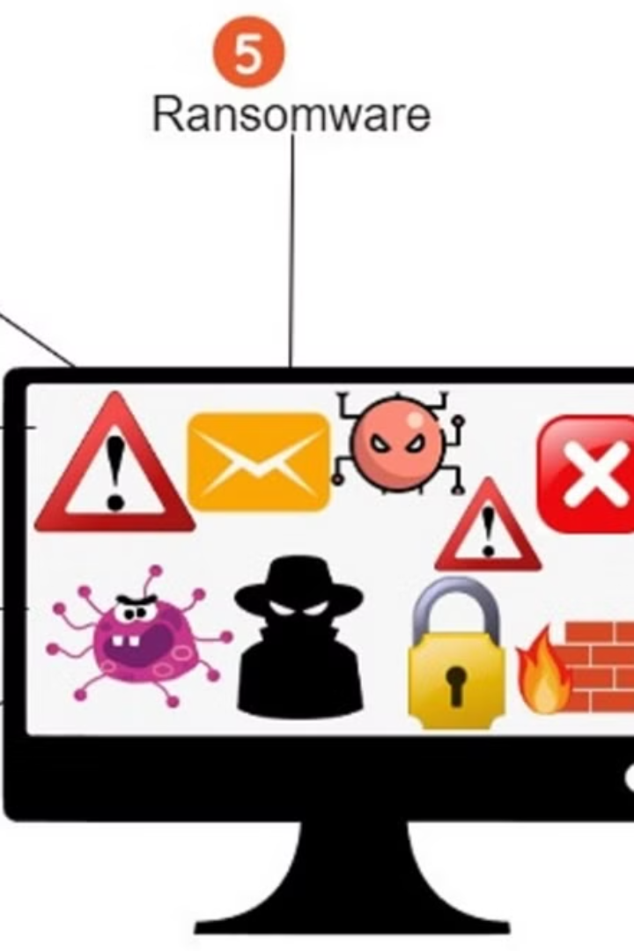
PROPOSED SYSTEM
The proposed system aims to leverage convolutional neural networks (CNN) for detecting malicious URLs efficiently and accurately. By analyzing website URLs, the system will identify potential threats and provide a layer of defense against cyber attacks.

Slide 3

PROBLEM STATEMENT
Malicious URLs
Sophisticated Techniques
Malicious URLs pose a significant threat by leading users to harmful sites.
Cybercriminals use advanced methods to disguise malicious links, making them hard to detect.
User Vulnerability
Users may unknowingly click on malicious URLs, leading to data breaches and cyber attacks.

Slide 4

PROPOSED SOLUTION
Utilizing Convolutional Neural Networks (CNN): Implementing a CNN architecture for detecting malicious URLs through pattern recognition.
Feature Engineering: Extracting relevant features from URLs, such as domain, path, and query parameters to enhance model performance.
Model Integration: Integrating the trained CNN model into the existing system for real-time URL scanning and detection.

Slide 5
SYSTEM APPROACH
Data Collection
1
Gather a diverse dataset of URLs, including both malicious and non-malicious examples.
2
Preprocessing
Clean and prepare the data, including feature extraction and transformation to facilitate model training.
Model Development
3
Train a Convolutional Neural Network (CNN) to learn patterns and identify malicious URLs.

Slide 6

ALGORITHM AND DEPLOYMENT
After developing the model, the next step is deploying it in a production environment with considerations for scalability and real-time processing.
An effective deployment strategy involves containerizing the model and utilizing cloud services for efficient management and monitoring.

Slide 7
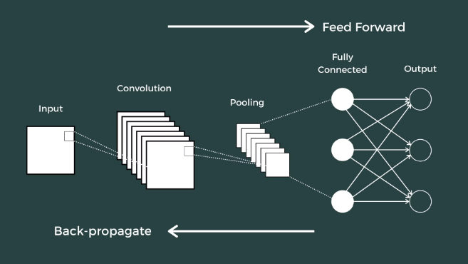
TRAINING AND PROCESS
Training the Convolutional Neural Network (CNN) involves feeding it a large dataset of URLs, both malicious and benign, to learn to differentiate between the two. This process requires carefully labeled data and iterative adjustments to the network's parameters.
Data preprocessing includes extracting features from URLs, balancing the dataset, and splitting it into training and validation sets. The CNN is trained using algorithms like backpropagation and gradient descent to optimize its performance.

Slide 8




PREDICTION PROCESS
Data Preparation
Clean and preprocess dataset for model input.
Model Prediction
Utilize trained CNN to predict malicious URLs.
Evaluation
Analyze model predictions for accuracy and efficiency.

Slide 9
RESULT
92%
0.02
10M
Accuracy
False Positive Rate
URLs Analyzed
High accuracy in malicious URL detection
Very low false positive rate in prediction
Massive volume of URLs analyzed for training
The system achieved a remarkable 92% accuracy in detecting malicious URLs, with an impressively low false positive rate of 0.02. It was trained with a massive dataset of 10 million URLs, ensuring robust analysis and prediction capabilities.

Slide 10
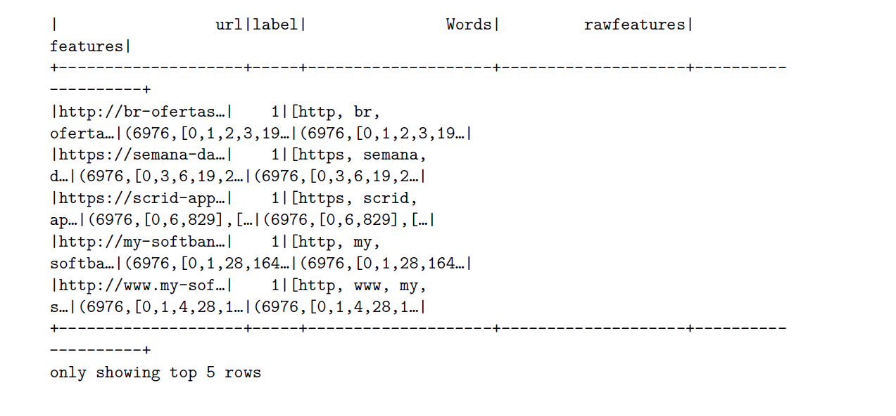
OUTPUT

Slide 11

Conclusion
After the rigorous process of training and validating the CNN model, the system offers a reliable and efficient method for detecting malicious URLs. With a high prediction accuracy rate, the system provides a valuable tool for cybersecurity professionals in combating online threats.
The deployment of the algorithm in real-time scenarios has demonstrated its effectiveness in identifying and mitigating potential risks, making it a crucial asset in maintaining digital security.

Slide 12



FUTURE SCOPE
Implementation of AI in Real-time Detection
1
Using advanced AI to detect malicious URLs in real time.
Integration with Cybersecurity Systems
2
Seamless integration with existing cybersecurity infrastructure.
Global Network for Threat Detection
3
Creating a global network for sharing threat intelligence.

Slide 13
REFERENCE
D. J. Lemay, R. B. Basnet, and T. Doleck, “Examining the relationship between threat and coping appraisal in phishing detection among college students,” Journal of Internet Services and Information Security, vol. 10, no. 1, pp. 38–49, 2020.
H. Kim, “5G core network security issues and attack classification from network protocol perspective,” Journal of Internet Services and Information Security, vol. 10, no. 2, pp. 1–15, 2020.
K. Aram and J. O. SoK, “A systematic review of insider threat detection,” Journal of Wireless Mobile Networks, Ubiquitous Computing, and Dependable Applications (JoWUA), vol. 10, no. 4, pp. 46–67, 2019.

